Slide 1


How does the policy affect the Brandenburg Residents?
Data Science for Agent Based Transport Simulations
Eduardo de Almeida Lima – 487663 Ibrahim Sayyed – 480326 Marius Vestner – 505217
Berlin, 16.12.2024

Slide 2
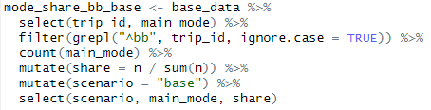
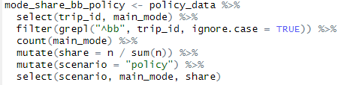
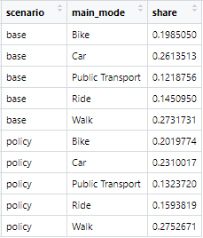
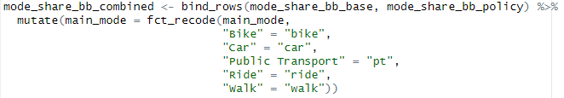
# Comparing Mode Share: Base vs. Policy Scenario
BASE
POLICY
Combining datasets:

Slide 3
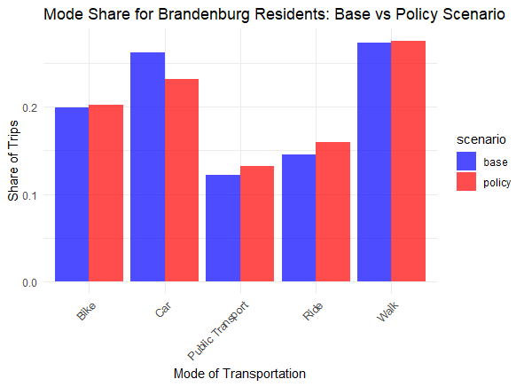
# Comparing Mode Share: Base vs. Policy Scenario

Slide 4

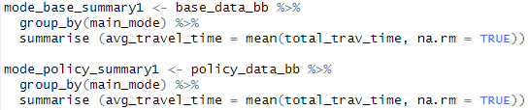
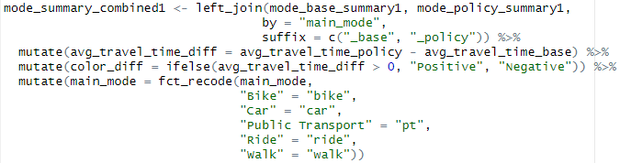
# Comparing Mean and Median Travel Time by Main Mode: Policy minus Base
MEAN, DATASET 1
MEDIAN, DATASET 2
mode_base_summary2
median
mode_policy_summary2
median
mode_summary_combined2

Slide 5
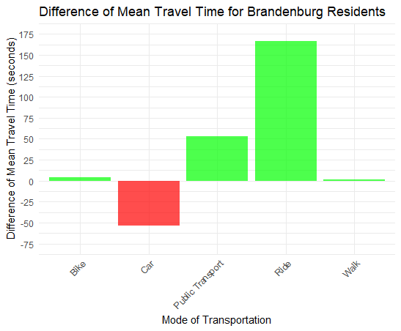
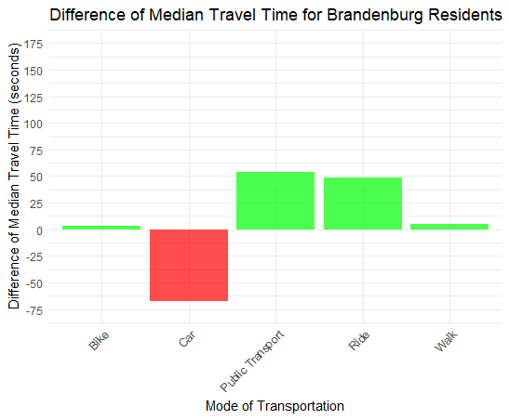
# Comparing Mean and Median Travel Time by Main Mode: Policy minus Base

